Slide 1
Precision Refinement of Banglish Text: NLP-Based Error Detection and Correction
Pitch Deck
20xx
</
/>
} /> [
Presented by
Rakesh Rakshit 19101588
Md Mohibur Zaman 19101359
Priya Saha 22241185
RA-MD HUMAION KABIR MEHEDI
ST-EHSANUR RAHMAN RHYTHM

Slide 2
</ Introduction
In our country, Banglish, a mix of Bengali and English, is increasingly being used on social media platforms. Understanding the meaning of a sentence largely relies on its structure and the words used. But some words can cause confusion in communication.
In our study, we tried to solve this issue by developing a system that suggests the closest words. This will enhance the efficiency of better texting communication in Banglish in any type of platform.

Slide 3
</ literature Review
NLP-based Typo Correction
Model for Croatian Language
Multilingual BERT, DistilBERT and XLM-RoBERTa.
Worked on two custom datasets.
2. Statistical Language Models for Spelling Error Detection with Web Search
New Word Acquisition
LM, LM+websearch
Used new articles to gather data.
3. Bangla Real-Word Error Detection and Correction Using Bidirectional LSTM and Bigram Hybrid Model
Effective use of bigram and bidirectional long short-term memory (LSTM)
82.86% accuracy
4. JODANI-a spell checking and suggesting tool for Gujrati language
Comparison between two spell checker -Jodani and Saras
Works for inflected words

Slide 4
</ literature Review
5. Design and implementation of NLP based Spell Checker for the Tamil Language
Identify misspelled terms in Tamil text and suggest correct words
Minimum edit distance algorithm is used
6. Language Model for Spell Checking of Educational texts in English
Developed a Kurdish language model with backoff smoothing
85% likelihood of correct suggestions appearing in top three suggestions
7. Adv-Bert:Bert is not robust on misspellings
An advanced transformer style NLP model to handle noisy inputs and keyboard errors.
8. Cipher: A Prototype Game with a Purpose for Detecting Errors in Text
Developed a game where users will annotate textual flaws
35 players tested the prototype and produced 4764 annotations.

Slide 5
</ Methodology
Dataset
Used custom dataset created by manual inputs.
Contains both correct and incorrect spelled data.
Correctly spelled data labeled as 1 and misspelled data labeled as 0.
Overall 1505 entries

Slide 6
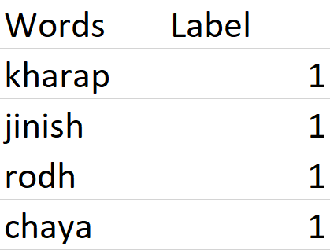
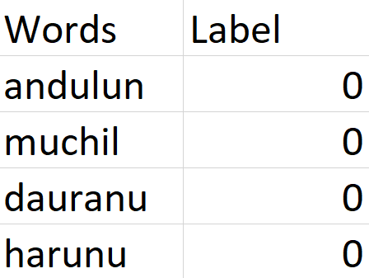
</ Methodology
Dataset
Correctly spelled word sample
misspelled word sample

Slide 7
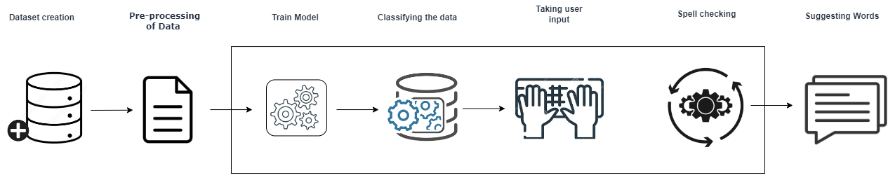
</ Methodology
2. Architecture
Multinomial Naive Bayes (MultinomialNB), Support Vector Machine (SVM), RandomForestClassifier, DecisionTreeClassifier, and Word2Vec-based classification models being used
Classification models classified correct and misspelled words
Minimum edit distance( Levenshtein distance) used for word suggestion based on user input

Slide 8
Spell Checking
Step 1. Takes input; the inputted word is going to check with words available in the word dictionary .
Step2. If matched, the result is true.
Step3. If not matched, it prepares a list of words where each word is compared with the word dictionary using the Levenshtein edit distance algorithm.
Step4. If similarity with any of the word dictionaries is 1.0 then the word will be marked as correct and it will return the word.
Step5. If its similarity less than 1.0 then the word is added to the suggestion list
Step6. Step3 will be proceed after words preparation where the list of suggestions will be returned based on maximum similarity value.

Slide 9
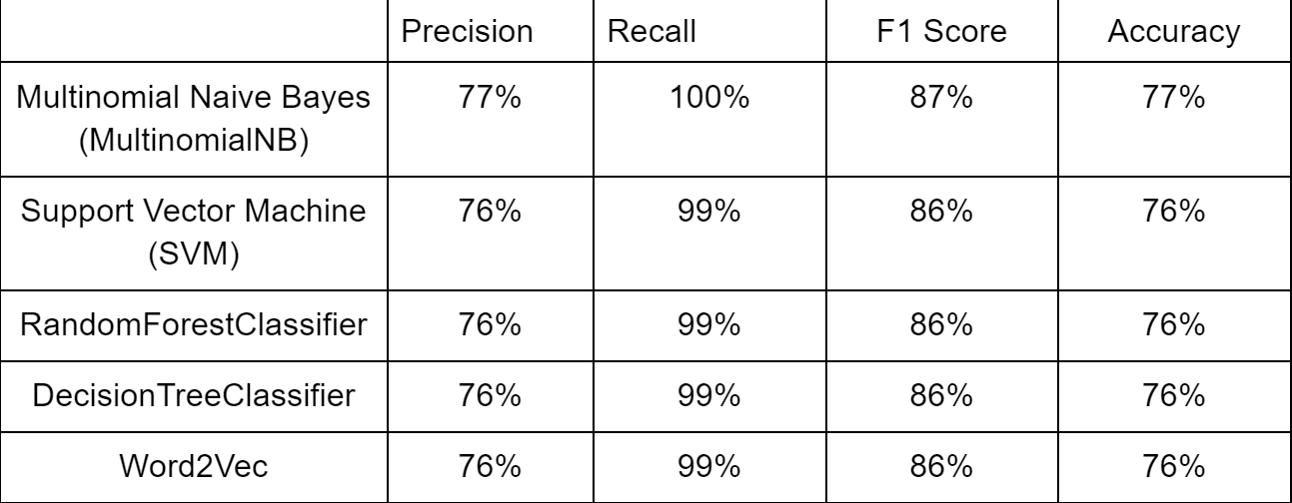
Experimental Results and Analysis:
Because of the size of dataset there is very little difference between the models
Multinomial Naive Bayes performed a bit better than the other models,with a precision rate of 77% and F1 score of 87%
Better performance in accuracy which is 77% for Multinomial Naive Bayes

Slide 10
</ Conclusion
Developed a spell checker for suggesting spelling mistakes in Banglish
By using minimum edit distance, it integrated word suggestion
on wrong words
</ Future Work
We will increase the size of the dataset
We will add more diversity of Banglish words in our dataset
We plan to use more complex models to get more accuracy

Slide 11
</ Thank You

